Slide 1

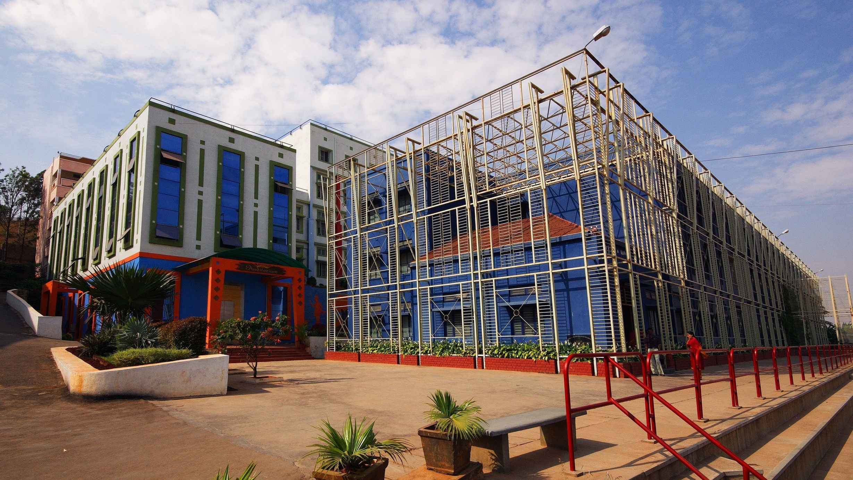



Sri Raghavendra Educational Institutions Society (R)
Sri Krishna Institute of Technology
(Approved by AICTE, Accredited by NAAC, Affiliated to VTU, Karnataka)
RECRUITMENT MANAGEMENT SYSTEM
ASHWIN G S 1KT20IS001
HEMANTH KUMAR N 1KT20IS006
Under the Guidance of
Ms. NAVEENA S.R
Assistant Professor
Department of Information Science Engineering, SKIT
www.skit.org.in

Slide 2
Sri Krishna Institute of Technology
(Approved by AICTE, Accredited by NAAC, Affiliated to VTU, Karnataka)
Content
Abstract
Introduction
Requirements
Block diagram
ER diagram
Queries
Front end design
Results
Conclusion
Future Enhancements
Project Title / 18CSP77
/skit.org.in
Dept. of ISE
2
RECRUITMENT MANAGEMENT SYSTEM / 18CSL58/skit.org.in

Slide 3
Sri Krishna Institute of Technology
(Approved by AICTE, Accredited by NAAC, Affiliated to VTU, Karnataka)
ABSTRACT
The RECRUITMENT MANAGEMENT SYSTEM (RMS) is a web-based application developed for HR department for hiring of employees. This system is helpful for HR department to make student selection process easy. The system aims to make the recruitment process more efficient and effective by providing a centralized location for all recruitment-related information and activities.
Dept. of ISE
3
RECRUITMENT MANAGEMENT SYSTEM / 18CSL58/skit.org.in

Slide 4
Sri Krishna Institute of Technology
(Approved by AICTE, Accredited by NAAC, Affiliated to VTU, Karnataka)
Introduction
A Recruitment Management System (RMS) is a software application that automates and streamlines the recruitment process for organizations.
It helps businesses to manage the entire hiring process, from posting job openings to tracking and evaluating job candidates.
The main purpose of an RMS is to make the recruitment process more efficient and effective by repetitive tasks and providing a centralized location for all recruitment-related information
Dept. of ISE
4
RECRUITMENT MANAGEMENT SYSTEM / 18CSL58/skit.org.in

Slide 5
Sri Krishna Institute of Technology
(Approved by AICTE, Accredited by NAAC, Affiliated to VTU, Karnataka)
Requirements
Software
Front End: JS, HTML, CSS, Bootstrap
Back End: MySQL, Xampp, Appache, PHP
Client OS: Window XP Or Higher
Hardware
Processor: Intel Corei3
RAM: 4/8 GB RAM
System Type: 32/64 bit processor
Monitor: VGA compatible(CRT or LCD-TFT)
Project Title / 18CSP77
/skit.org.in
Dept. of ISE
5
RECRUITMENT MANAGEMENT SYSTEM / 18CSL58/skit.org.in

Slide 6
Sri Krishna Institute of Technology
(Approved by AICTE, Accredited by NAAC, Affiliated to VTU, Karnataka)
Block diagram
Find Vacancies
USER
Storing Data
DATABASE
Apply for specific position
Admin
Login to RMS
Check Credentials
View Application
Response
Manager Modules
Manage Application
Settings
Vacancy
Status Category
User
Project Title / 18CSP77
/skit.org.in
Dept. of ISE
6
RECRUITMENT MANAGEMENT SYSTEM / 18CSL58/skit.org.in

Slide 7
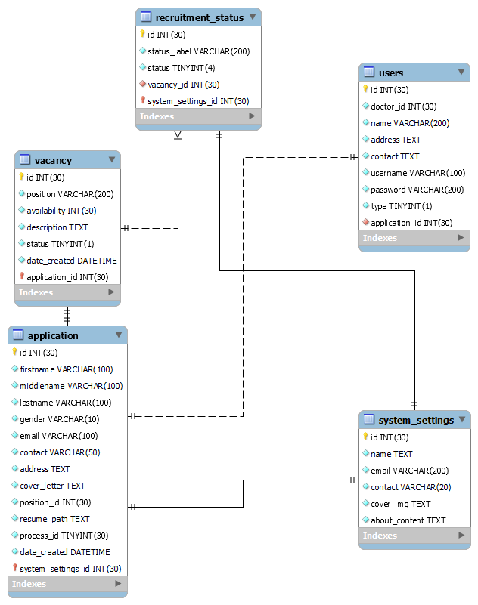
Sri Krishna Institute of Technology
(Approved by AICTE, Accredited by NAAC, Affiliated to VTU, Karnataka)
E R diagram
Project Title / 18CSP77
/skit.org.in
Dept. of ISE
7
RECRUITMENT MANAGEMENT SYSTEM / 18CSL58/skit.org.in

Slide 8
Sri Krishna Institute of Technology
(Approved by AICTE, Accredited by NAAC, Affiliated to VTU, Karnataka)
Front End Design
JS
HTML
CSS .
BOOTSTRAP
Project Title / 18CSP77
/skit.org.in
Dept. of ISE
8
RECRUITMENT MANAGEMENT SYSTEM / 18CSL58/skit.org.in

Slide 9
Sri Krishna Institute of Technology
(Approved by AICTE, Accredited by NAAC, Affiliated to VTU, Karnataka)
Results
The project was designed in such a way that future modifications can be done easily.
The following conclusions can be deduced from the development of the project:
Automation of the entire system improves productivity.
It provides a friendly graphical user interface which proves to be better when compared to the existing system.
It gives appropriate access to the authorized users depending on their permissions.
It effectively overcomes the delay in communications.
Updating of information becomes so easier.
System security, data security are the striking features.
The system has adequate scope for modification in future if it is necessary.
Project Title / 18CSP77
/skit.org.in
Dept. of ISE
9
RECRUITMENT MANAGEMENT SYSTEM / 18CSL58/skit.org.in

Slide 10
Sri Krishna Institute of Technology
(Approved by AICTE, Accredited by NAAC, Affiliated to VTU, Karnataka)
Conclusion
Recruitment Management System has been designed and tested.
Integrating features of all the software components used have developed in it.
With the help of growing technology, the project has been successfully implemented.
Project will reduce the human effort and make the task of admin and users easier.
It is efficient to use and easy to work on it.
Project Title / 18CSP77
/skit.org.in
Dept. of ISE
10
RECRUITMENT MANAGEMENT SYSTEM / 18CSL58/skit.org.in

Slide 11
Sri Krishna Institute of Technology
(Approved by AICTE, Accredited by NAAC, Affiliated to VTU, Karnataka)
Future Enhancements
This project can be further enhanced by adding cloud server like Firebase, AWS. Using Real time server aspects like authentication, management of multiple applicants can be done precisely.
Project Title / 18CSP77
/skit.org.in
Dept. of ISE
11
RECRUITMENT MANAGEMENT SYSTEM / 18CSL58/skit.org.in

Slide 12

Sri Krishna Institute of Technology
(Approved by AICTE, Accredited by NAAC, Affiliated to VTU, Karnataka)
Discussion
RECRUITMENT MANAGEMENT SYSTEM / 18CSL58/skit.org.in

Slide 13

Sri Krishna Institute of Technology
(Approved by AICTE, Accredited by NAAC, Affiliated to VTU, Karnataka)
RECRUITMENT MANAGEMENT SYSTEM / 18CSL58/skit.org.in

